Slide 1


Simcha Ecommerce Website
Presented By:
Aashif Maharjan
7-2-410-191-2020

Slide 2
TABLE OF CONTENTS
1) Introduction
2) Problem Statement
3)Objectives
4)Tools used
5)Used case diagram
6)Activity diagram of Admin
7)Activity diagram of User
8)Methodology used
9) Conclusion
10) Demo
2
Notes:
Hello

Slide 3
INTRODUCTION
Simcha Ecommerce Website involves creating a online marketplace, allowing customers to purchase and engage with these unique products more meaningfully.
A customer can directly communicate with the owner in the chat box and order a customized designed of their choice.
Two modules: Admin and user
3

Slide 4
PROBLEM STATEMENT
No common system for product listing.
Inefficient order status tracking.
Poor customer communication
4

Slide 5
OBJECTIVES
To deploy an online portal that enables customers to access a catalog, search for wooden handicrafts, notebook, key rings as well as use their accounts to order products made by local artisans.
To include a chat box feature, enabling customers to request and design customized products of their choice.
5

Slide 6
TOOLS USED
HTML
CSS
Javascript
PHP
MySQL
Xampp
6

Slide 7
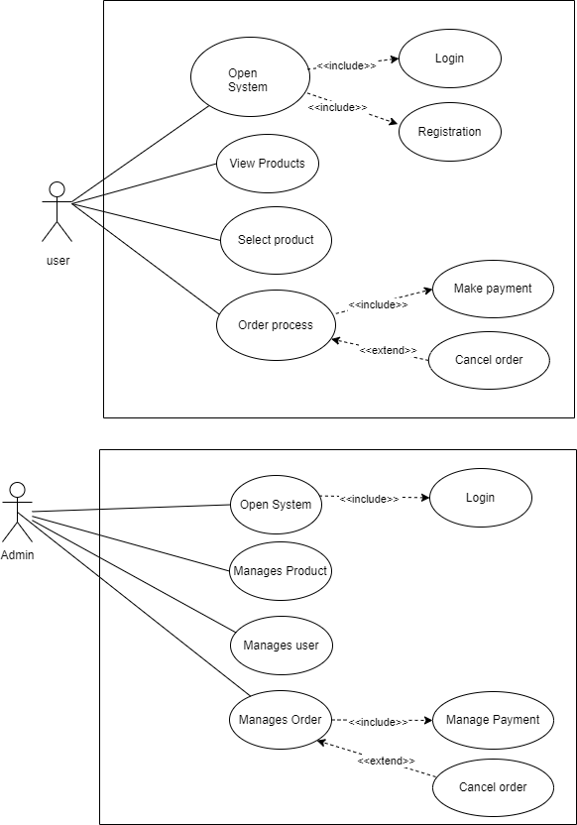
USE CASE DIAGRAM
7

Slide 8
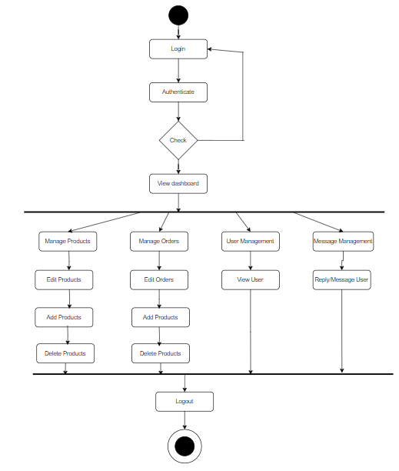
ACTIVITY DIAGRAM OF ADMIN
8

Slide 9
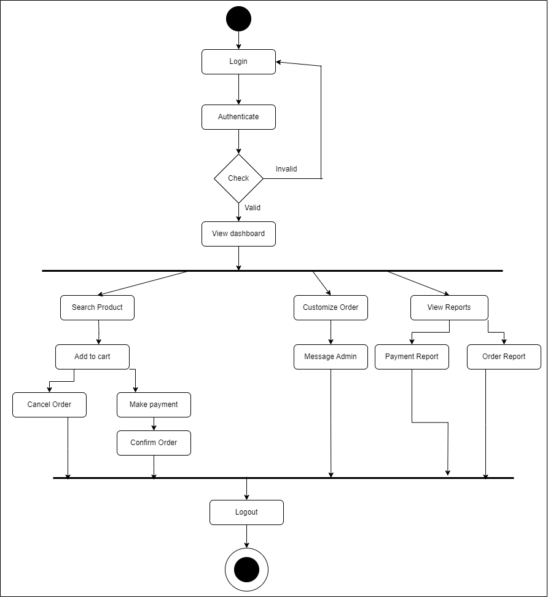
ACTIVITY DIAGRAM OF USER
9

Slide 10
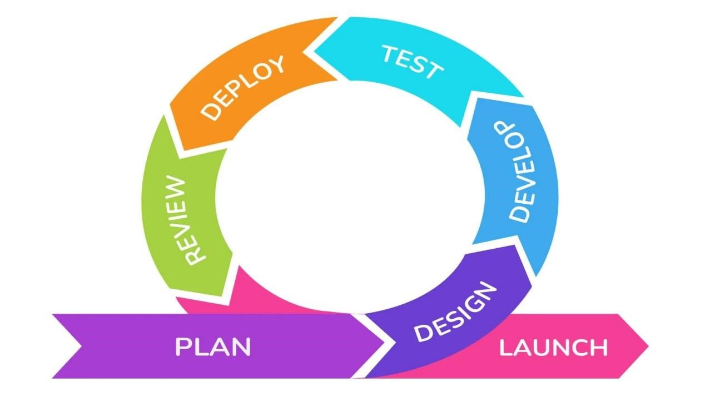
METHODOLOGY USED
Fig: Agile Methodology
10

Slide 11
CONCLUSION
Through PHP, MySQL, JavaScript, HTML and CSS, Simcha Shop showcases the power of technology to create responsive and interactive online shop.
Simcha has the functionality to add and view products
Simcha also gives the functionality to chat with owner to customize their own design.
11

Slide 12
DEMO!
12

Slide 13
Thank You!
13

